Slide 1

National Institute Of Technology Raipur
Department of Metallurgical and Materials Engineering
Presentation topic:-
Data-Driven Analysis of Metallurgical Properties using Machine Learning
ANKAN MONDAL (23120014)
DRISHTI YADAV (23120036)
YUVRAJ SINGH (23120112)

Slide 2
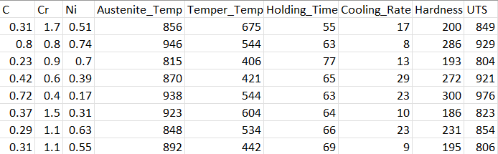
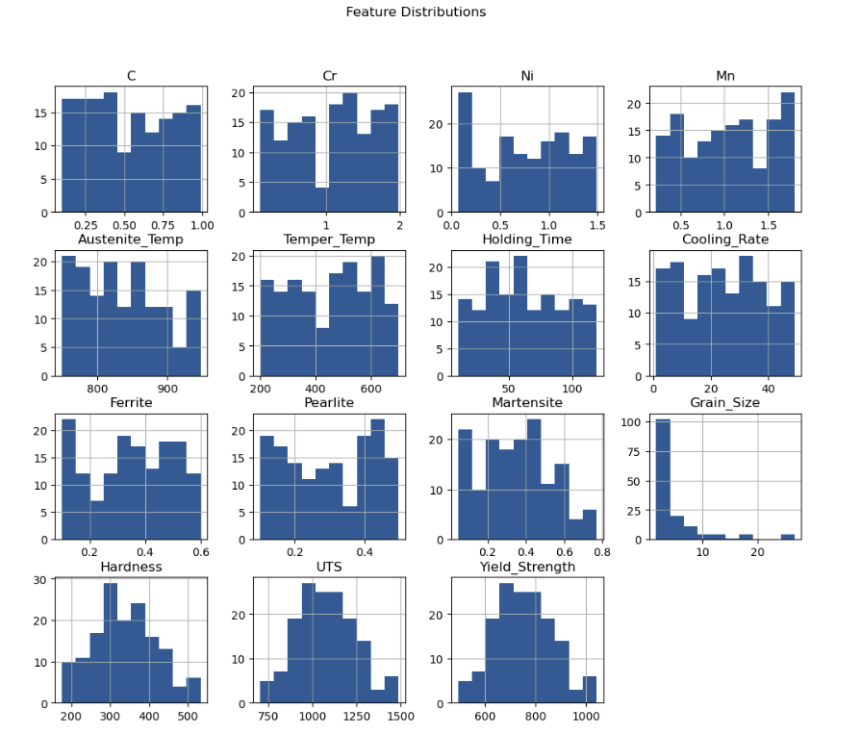
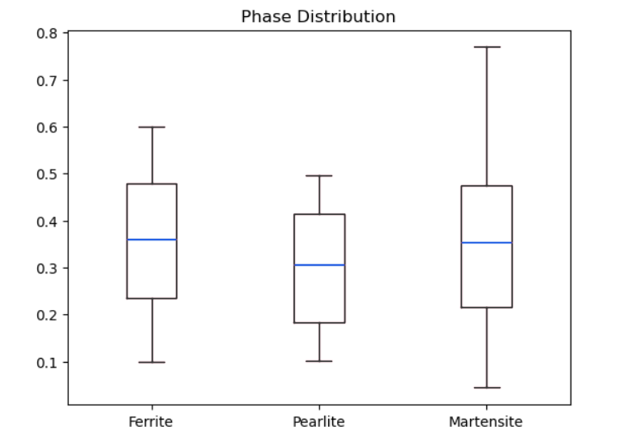
Exploratory Data Analysis
Dataset is well distributed (no major bias)
Covers composition + processing + microstructure + properties
Cooling rate varies widely → major influencing factor
Martensite variation → controls hardness
Grain size mostly small → higher strength trend
Mechanical properties are normally distributed → good for ML
KEY INSIGHT
Cooling Rate ↑ → Martensite ↑ → Hardness ↑
Martensite shows highest variation → major strength driver
Ferrite & Pearlite more stable phases

Slide 3
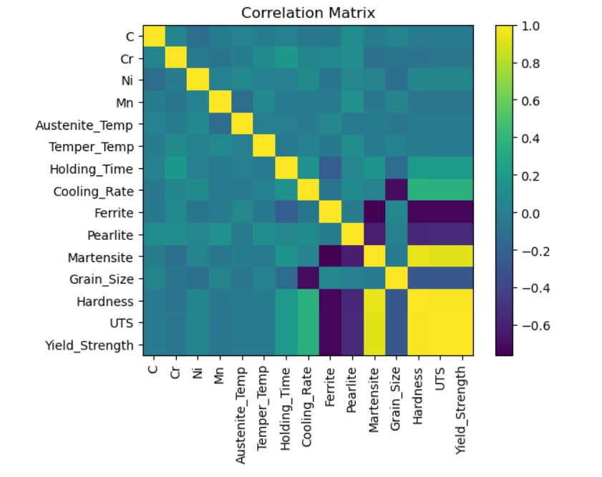
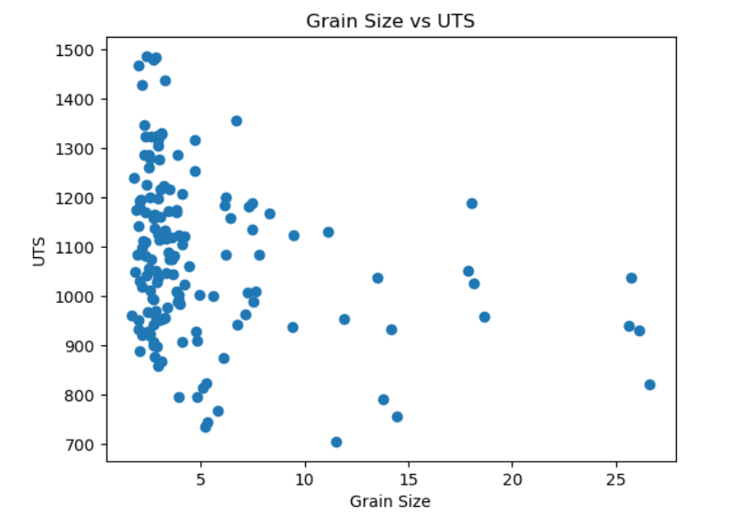
Correlation Matrix Insights
Hardness, UTS, Yield Strength → strongly correlated
Martensite ↑ → Hardness ↑ (strong positive relation)
Ferrite ↑ → Strength ↓ (negative relation)
Grain Size ↑ → Strength ↓ (Hall-Petch relation)
Clear inverse relation
Grain Size ↓ → UTS ↑ (Hall–Petch effect)
Fine grains → stronger material

Slide 4
Dataset Overview
150 SAMPLES, 15 FEATURES → BALANCED DATASET
COVERS COMPOSITION + HEAT TREATMENT + MICROSTRUCTURE + PROPERTIES
NO MISSING VALUES → CLEAN DATASET
Statistical Insights
Properties (Hardness, UTS, YIELD) SHOW WIDE RANGE → GOOD VARIABILITY
GRAIN SIZE HAS HIGH VARIATION → STRONG IMPACT FACTOR
COOLING RATE VARIES SIGNIFICANTLY → IMPORTANT PROCESS PARAMETER
Skewness Insight
MOST FEATURES ≈ NORMALLY DISTRIBUTED (NEAR 0 SKEW)
GRAIN SIZE HIGHLY SKEWED → NON-UNIFORM GRAIN DISTRIBUTION
SUITABLE FOR ML MODELS (NO MAJOR TRANSFORMATION NEEDED)
CLEAN AND WELL-DISTRIBUTED DATASET CAPTURING REALISTIC METALLURGY BEHAVIOR, IDEAL FOR MACHINE LEARNING ANALYSIS.

Slide 5
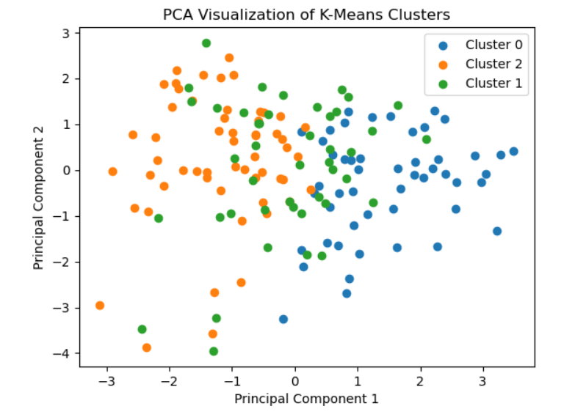
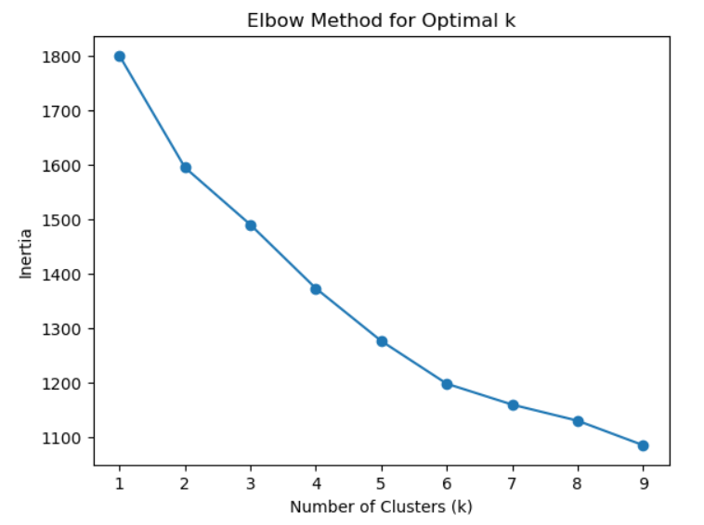
K MEANS CLUSTERING (UNSUPERVISED LEARNING)
Elbow Method for Optimal Clusters
The elbow method graph shows a sharp decrease in inertia from k = 1 to k = 3, after which the decrease becomes gradual. This indicates that k = 3 is the optimal number of clusters for the dataset.
Data is grouped into 3 distinct clusters using PCA
Clustering is based on composition, heat treatment, and microstructure
One cluster represents high-strength (martensitic) materials
One cluster represents ductile (ferrite–pearlite) materials
One cluster shows balanced/intermediate properties
Slight overlap indicates gradual transition between material behaviors

Slide 6
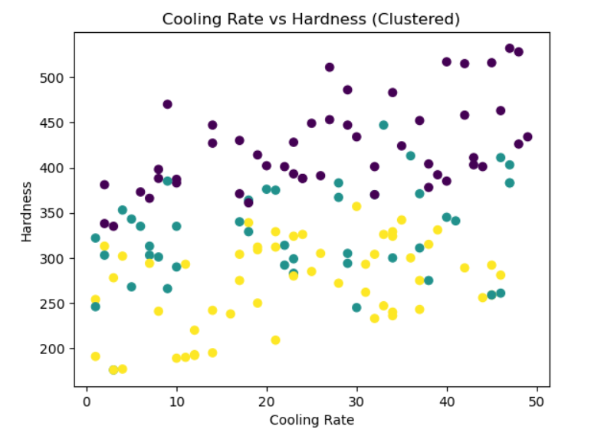
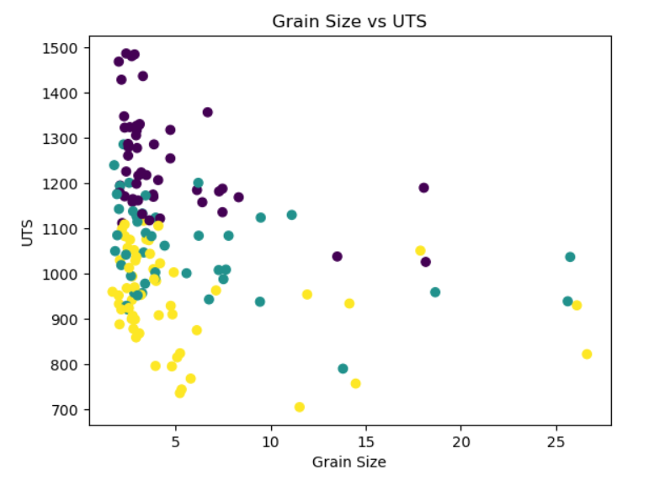
Plot shows relationship between Grain Size and UTS (Ultimate Tensile Strength)
UTS decreases as grain size increases (inverse relationship)
Smaller grain size leads to higher strength (grain boundary strengthening)
Larger grains result in lower strength and more ductile behavior
High UTS cluster → fine grains + stronger microstructure (martensitic/tempered)
Low UTS cluster → coarse grains + ferrite–pearlite structure
Clusters represent different microstructural conditions in the dataset
Some scattered points indicate variation due to composition and heat treatment
Plot shows relationship between Cooling Rate and Hardness in the dataset
Hardness increases with increasing cooling rate (positive trend)
Faster cooling promotes martensite formation → higher strength
Lower cooling rates lead to ferrite–pearlite → lower hardness
Clusters represent different heat treatment conditions and microstructures
High hardness cluster → rapid cooling, martensitic structure
Low hardness cluster → slow cooling, ductile structure
Overlap indicates gradual transition between microstructures

Slide 7
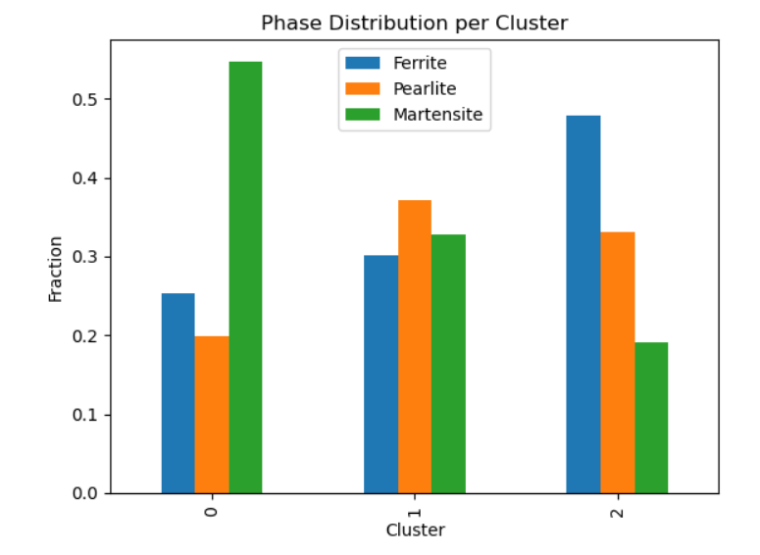
FINAL INSIGHTS (K-Means + PCA)
Overall Clustering Insight
Dataset is successfully divided into 3 meaningful material clusters
Clustering is based on composition + heat treatment + microstructure + properties
PCA confirms clear separation with slight overlap → real-world behavior
Microstructure–Property Relationship
High martensite → High hardness & UTS → brittle behavior
High ferrite–pearlite → Low strength → ductile behavior
Confirms fundamental metallurgy principles
Heat Treatment Insight
Higher cooling rate → higher hardness (martensite formation)
Lower cooling rate → softer ferrite–pearlite structure
Shows strong link:
Process → Structure → Property
Grain Size Effect
Smaller grain size → higher UTS
Larger grain size → lower strength
Validates Hall–Petch relationship
Plot shows phase distribution across clusters
Each cluster represents different microstructural composition in the dataset
Cluster 0 → High martensite (~0.55)
→ Indicates high strength, brittle (quenched steel)
Cluster 1 → Balanced ferrite, pearlite, martensite
→ Represents tempered steel with moderate properties
Cluster 2 → High ferrite (~0.48), low martensite (~0.19)
→ Indicates ductile, low-strength material (ferrite–pearlite)
Clustering successfully separates materials based on microstructure–property relationship
Shows strong link between heat treatment → phase formation → mechanical properties
Data grouped into 3 meaningful material clusters
Each cluster represents a distinct metallurgical behavior
Cluster 0 → High martensite → High hardness (quenched steel)
Cluster 1 → Balanced phases → Moderate properties (tempered steel)
Cluster 2 → Ferrite-rich → Low hardness (ductile steel)
Shows natural grouping in materials without labels
PCA Insight
PCA reduced high-dimensional data → 2D visualization
First 2 components capture ~32% variance
Even with reduced dimensions, clusters remain distinguishable
Indicates strong underlying structure in data

Slide 8
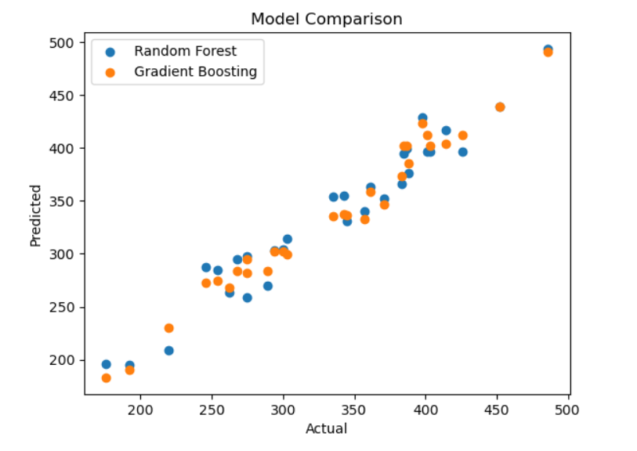
RANDOM FOREST & GRADIENT BOOSTING (SUPERVISED LEARNING)
Plot compares Actual vs Predicted Hardness values for the dataset
Both models (Random Forest & Gradient Boosting) closely follow actual values
Points lie near diagonal → high prediction accuracy
Confirms strong relationship between input features (composition, heat treatment, microstructure) and hardness
Both models accurately predict hardness, validating that material properties are strongly governed by composition, heat treatment, and microstructure in the dataset.
Hardness accurately predicted using
Cooling Rate (↑ cooling → ↑ hardness)
Martensite fraction (↑ martensite → ↑ hardness)
Grain Size (↓ grain size → ↑ strength & hardness)
Alloy composition (C, Cr, Ni, Mn influence hardenability)
Compared to Random Forest
Gradient Boosting slightly more precise
Better at capturing small variations in dataset

Slide 9
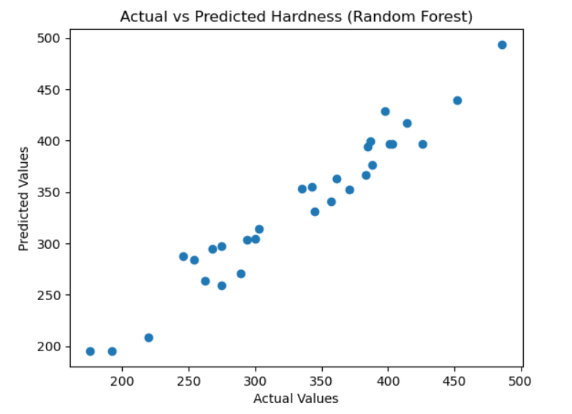
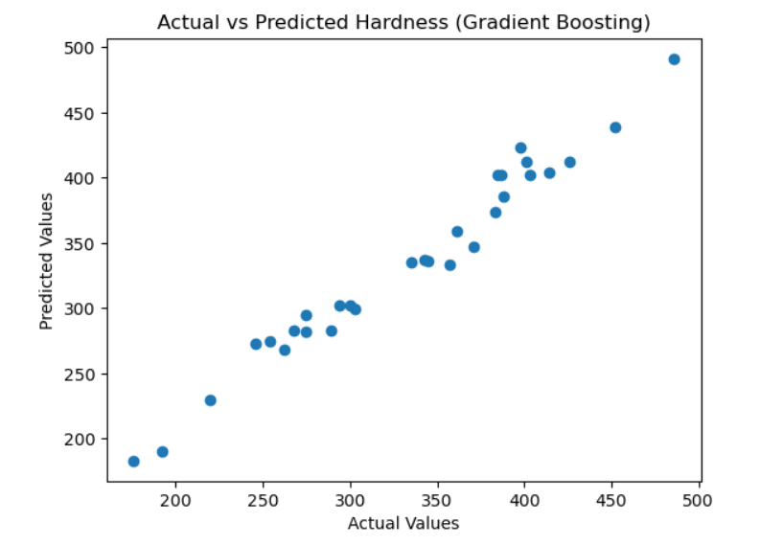
Model Performance Insight
Model Performance Insight
Points lie close to diagonal → high prediction accuracy
Indicates Random Forest captures strong patterns in dataset
Very few outliers → low prediction error
Points closely aligned along diagonal → high prediction accuracy
Very small spread → low error & good generalization
Gradient Boosting captures fine variations better
Engineering Interpretation
Engineering Interpretation
High hardness regions correspond to High martensite fraction
Lower hardness regions correspond toFerrite–pearlite like structures
High hardness predictions : Martensitic structures
Medium hardness: Tempered structures
Low hardness : Ferrite–pearlite like microstructure

Slide 10
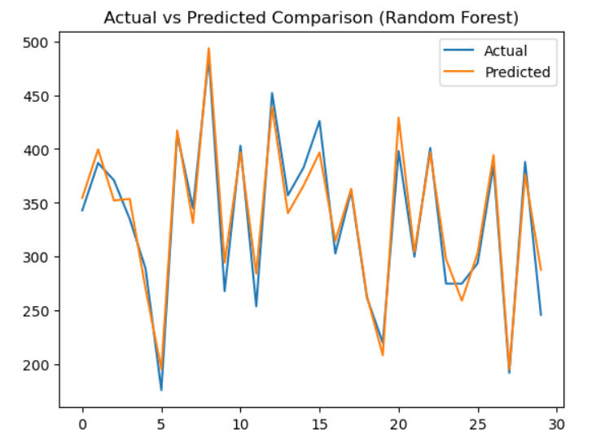
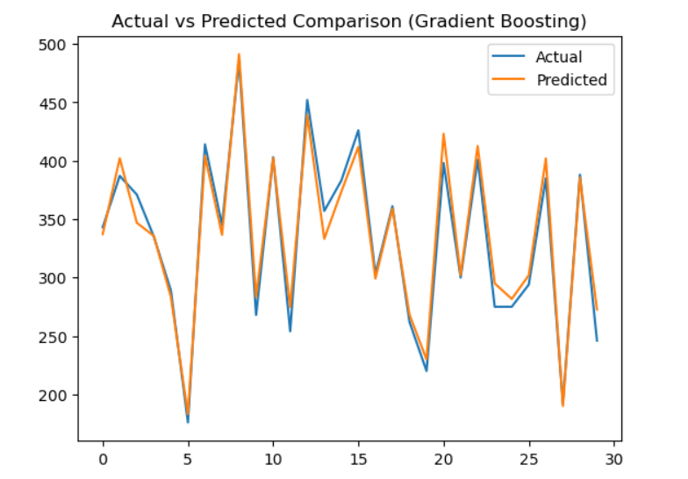
Key Takeaway
Engineering Interpretation
Both models effectively predict hardness from metallurgical parameters
Gradient Boosting slightly outperforms Random Forest
Peaks in graph → high martensite / rapid cooling
Valleys → ferrite-pearlite structures / slower cooling
Smooth transitions → tempered or mixed microstructures

Slide 11
Process–Structure–Property Link
Key Engineering Insight
Cooling Rate ↑ → Martensite ↑ → Hardness ↑
Grain Size ↓ → Strength & UTS ↑
Ferrite/Pearlite ↑ → Ductility ↑, Hardness ↓
Our ML results validate core metallurgy principles
Hardness can be predicted before actual testing
Enables:
Faster material design
Reduced experimental cost
Optimization of heat treatment parameters
Supervised Learning Insight
Both models show:
High R² (0.94–0.96) → Strong predictive power
Low MAE → Accurate predictions
Gradient Boosting slightly better → captures fine nonlinear trends
Model Reliability Insight
Train ≈ Test score → No major overfitting
Models generalize well → usable for real predictions
This approach can be extended to alloy design, heat treatment optimization, and smart manufacturing (Industry 4.0)

Slide 12
Summary
Analyzed a metallurgical dataset linking composition, heat treatment, microstructure, and mechanical properties
Performed EDA to understand distributions, correlations, and key material behavior
Applied K-Means clustering with PCA to identify distinct material groups based on properties
Built supervised models (Random Forest & Gradient Boosting) to predict hardness accurately
KEY INSIGHTS
Microstructure (especially martensite) strongly controls hardness and strength
Grain size inversely affects strength (Hall–Petch relationship observed)
Cooling rate influences phase formation, impacting final properties
Strong correlation between Hardness, UTS, and Yield Strength
MODEL PERFORMANCE
FINAL CONCLUSION
Both models achieved high accuracy (R² ≈ 0.95–0.97)
Gradient Boosting performed slightly better than Random Forest
Predictions closely match actual values → reliable model
Successfully demonstrated data-driven understanding of metallurgy
ML models can predict material properties from process parameters
Approach can be used for material design and optimization

Slide 13

THANK YOU !

